Slide 1
Systems Cycles & Processes

Slide 2




Revenue Cycle & Processes
INVOICE
AIS checks the customer’s history
Customer orders goods
Goods shipped
Customer billed

Slide 3
Revenue Cycle & Processes
Update Sales Journal
Update customer account in the ledger
AIS
Update Inventories account in the ledger
AIS (after the transaction has taken place)

Slide 4
Revenue Cycle & Processes
Send customer statement
Receive cash from customer
AIS
Receipt given to customer
Update the Cash Receipts Journal
Update customer account in the ledger
AIS (at the end of the month)

Slide 5
Revenue Cycle & Processes
Produce useful reports about Sales or the customers (outstanding amounts)
AIS
AIS (at any time)

Slide 6

Expenditure Cycle & Processes
Purchase order (must be authorised)
AIS
INVOICE
Business orders goods from supplier
Receive goods
Receive invoice (compare to what was ordered)

Slide 7
Expenditure Cycle & Processes
Update Purchases Journal
Update supplier account in the ledger
AIS
Update Inventories account in the ledger
AIS (after the transaction has taken place)

Slide 8
Expenditure Cycle & Processes
Receive supplier statement (check against invoices)
Pay supplier (must be authorised)
AIS
Update the Cash Payments Journal
Update supplier account in the ledger
AIS (at the end of the month)

Slide 9
Expenditure Cycle & Processes
Produce useful reports about purchases or the suppliers (outstanding amounts)
AIS
AIS (at any time)

Slide 10
Inventory management Processes
Re-order prompt
Purchase order (must be authorised)
AIS
Inventory updated
Purchase of stock
AIS
Inventory updated
AIS
Sale of stock

Slide 11
Inventory management Processes
Stock levels
Stock reports
AIS
AIS (at any time)

Slide 12

Admin Cycles & Processes
Wages paid by bank transfer
AIS (Payroll : deductions
PAYE, etc)
Employee hours

Slide 13
Admin Cycles & Processes
List of staff
Total hours
AIS
Job description
Leave taken
Summary of deductions
AIS (at any time)

Slide 14
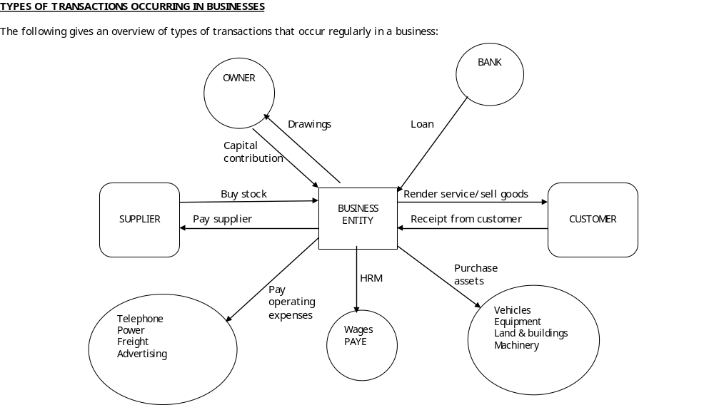
Summary Cycles & Processes

